Slide 1

CSCI E-96 Data Mining, Discovery and Exploration Efficient Similarity Search
Steve Elston
Copyright 2021, 2022, 2023, 2024, 2025, Stephen F Elston. All rights reserved.

Slide 2
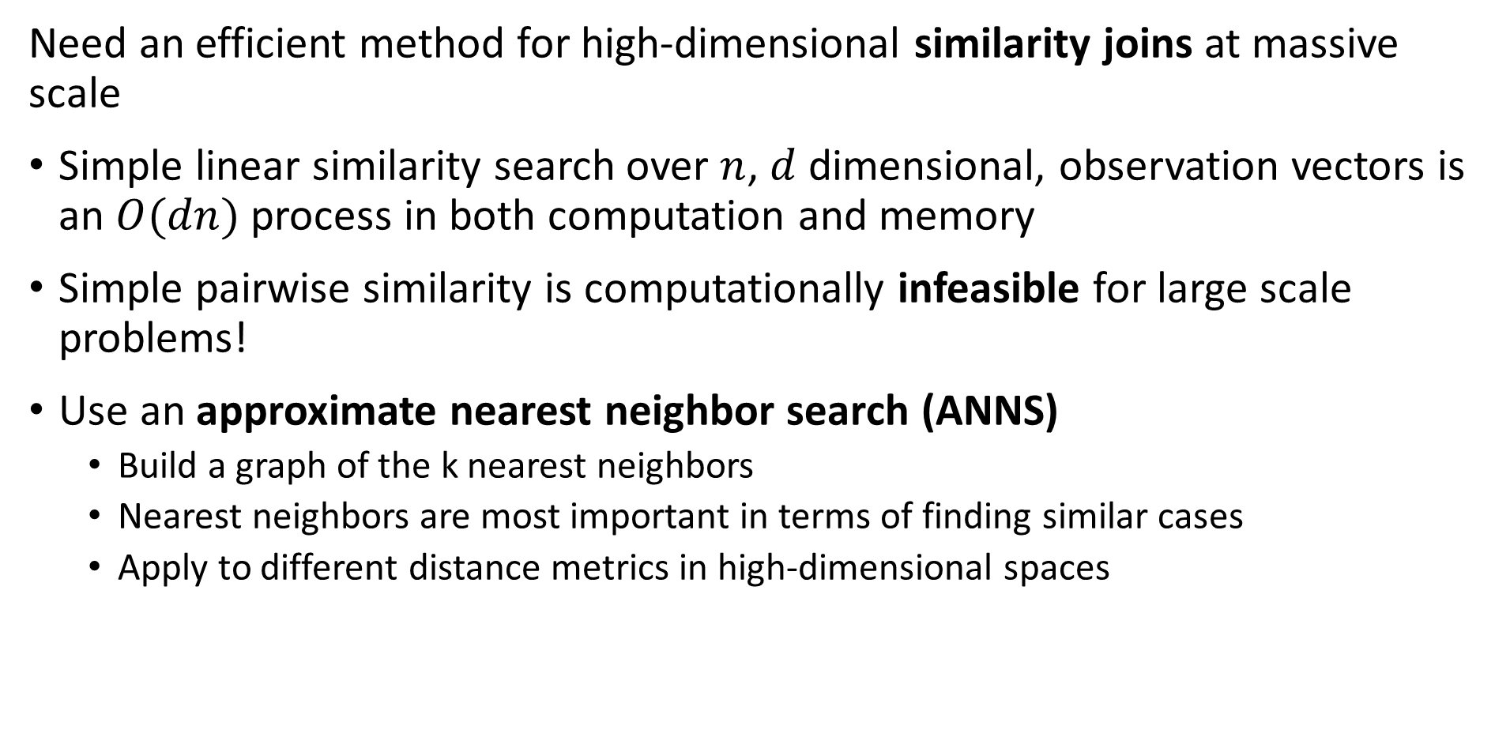
Similarity Search at Scale
Need an efficient method for high-dimensional similarity joins at massive scale
Simple linear similarity search over $n$, $d$ dimensional, observation vectors is an $O(dn)$ process in both computation and memory
Simple pairwise similarity is computationally infeasible for large scale problems!
Use an approximate nearest neighbor search (ANNS)
Build a graph of the k nearest neighbors
Nearest neighbors are most important in terms of finding similar cases
Apply to different distance metrics in high-dimensional spaces

Slide 3
Similarity Search at Scale
Need an efficient method for high-dimensional similarity joins at massive scale
Constructing nearest-neighbor graphs
Retrieval Augmented Generation (RAG) models for generative AI
Cluster models
Dimensionality reduction
Find similar products and for recommendation
Find similar documents
Web search
Document search
Deduplication
Plagiarism detection
Search for similar images

Slide 4
Similarity Search at Scale
Massive scale similarity search is at the core of many analytics and AI platforms
There is wide landscape of technologeies available for the similarity search problem
Vector databases incorporate massive scale similarity search including,
Pinecone
Milvus from Zilli
Chroma
Weaviate
…
Cloud platforms often include massive scale similarity search including,
ElasticSearch
Azure AI Search

Slide 5
Similarity Search at Scale
Massive scale similarity search is at the core of many analytics and AI platforms
There are several vector similarity search platforms for recommender systems, document serach and web search in use including,
Approximate Nearest Neighbor Search Oh Yeah (Annoy) from Spotify
Qdrant
Vearch-Gamma
Vespa
…
We will focus on Facebook AI Similarity Search (FAISS)
FAISS is widely used as a basis for many similarity search platforms
We will explore specific solutions using these algorithms in subserquent lessons

Slide 6
Similarity Search at Scale
Pipeline for similarity joins at massive scale
Our goal is to find rapidly approximate nearest neighbors with high recall
No one method can achieve this goal
In practice use a pipeline which concatenates several methods
Distance (Similarity) Metric
Dimensionality Reduction (Embedding)
Create D dimensional numeric embedding vectors
PCA
Neural Embedding
Etc.
Coarse Quantization
Reduce scope for ANN search
Inverted file - IVF
IVF Product quantization (IVF-PQ)
Inverted Multi-Index (IMI)
IVF Hierarchical Navigable Small Worlds (HNSW)
Etc…
Fine Quantizaton
Further reduce search scope and improve recall
Exhaustive search – Flat
Residual PQ
Locally Sensitive Hashing (LSH)
Search Refinemnet
Increase recall for NN search
Flat
Residual PQ algorithm

Slide 7
Similarity Search at Scale
We need an efficient way to (approximately) perform similarity joins at massive scale
Need an efficient method for large-scale and high-dimensional similarity joins!
Broadly, there are four classes of ANNS algorithms
Tree search
Hash-based search
Quantization-based search
Graph search
Apply to appropriate distance metrics in high-dimensional spaces

Slide 8
Similarity Search at Scale
Dimensionality reduction often applied to similarity serarch
It is easier to search in a lower-dimensional space
Many possible transformations to lower-dimensional embedding space
Some algorithms start with a nearest neighbor similarity search!
Can use a neural network to find an embedding space, but computationally intensive
Ideally want an orthogonal embedding space
More on dimensionality reduction in other lessons

Slide 9
Flat Similarity Search

Slide 10
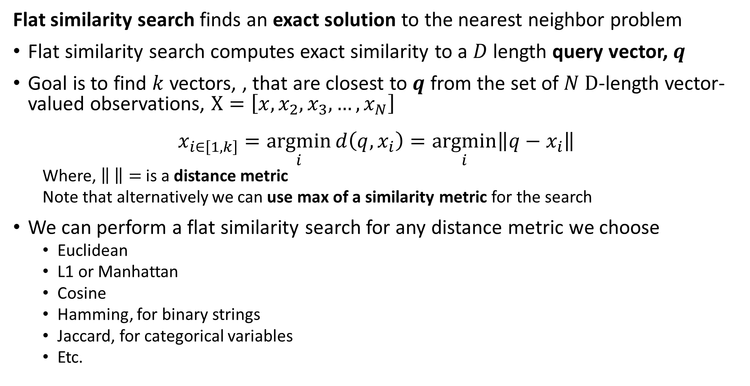
Flat similarity search finds exact solution
Flat similarity search finds an exact solution to the nearest neighbor problem
Flat similarity search computes exact similarity to a $D$ length query vector, $q$
Goal is to find $k$ vectors, , that are closest to $q$ from the set of $N D$-length vector-valued observations, $X=\left[x,x_{2},x_{3},…,x_{N}\right]$
$$x_{i∈\left[1,k\right]}=\underset{i}{argmin}{d\left(q, x_{i}\right)}=\underset{i}{argmin}{{\left\|q−x_{i}\right\|}^{ }}$$
Where, $\left\| \right\|=$ is a distance metric
Note that alternatively we can use max of a similarity metric for the search
We can perform a flat similarity search for any distance metric we choose
Euclidean
L1 or Manhattan
Cosine
Hamming, for binary strings
Jaccard, for categorical variables
Etc.

Slide 11
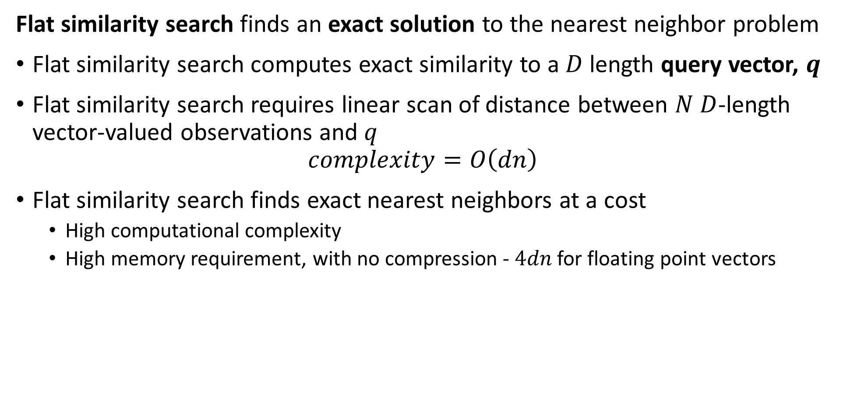
Flat similarity search finds exact solution
Flat similarity search finds an exact solution to the nearest neighbor problem
Flat similarity search computes exact similarity to a $D$ length query vector, $q$
Flat similarity search requires linear scan of distance between $N$ $D$-length vector-valued observations and $q$
$$complexity=O\left(dn\right)$$
Flat similarity search finds exact nearest neighbors at a cost
High computational complexity
High memory requirement, with no compression - $4dn$ for floating point vectors

Slide 12
Flat similarity search finds exact solution
Is any similarity search truly exact?
Unlikely!
Distance is dependent on the distance metric used
Dimensionality reduction (embedding) provides only an approximate representation of original vector
Vector valued observations are subject to noise
In reality we only need an NN similarity search good enough for our task

Slide 13
Evaluation of ANNS

Slide 14
Evaluation of ANNS
How do we objectively evaluate ANNS algorithms
There are three dimensions of performance
Recall measures the fraction of true NNs found by the algorithm
Memory use can be the biggest constraint for massive data sets
Speed can be important for many applications
Is an invariable trade off between these three dimensions
Example, we can have high recall if we have sufficient memory and computational capacity
Generally we must pick two of the three dimensions and accept the third
Low Memory -Scalable
?
Low Computational Complexity-Scalable
High Recall -Accuracy

Slide 15
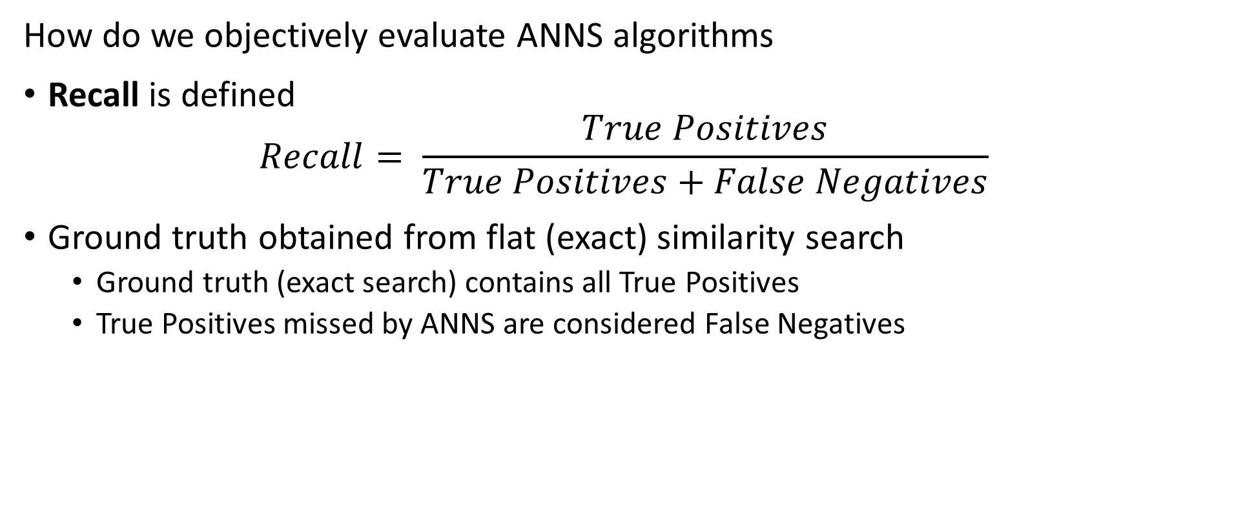
Evaluation of ANNS
How do we objectively evaluate ANNS algorithms
Recall is defined
$$Recall= \frac{True Positives}{True Positives+False Negatives}$$
Ground truth obtained from flat (exact) similarity search
Ground truth (exact search) contains all True Positives
True Positives missed by ANNS are considered False Negatives

Slide 16
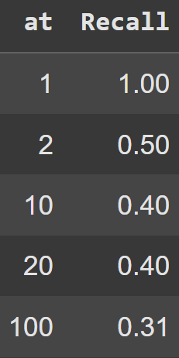
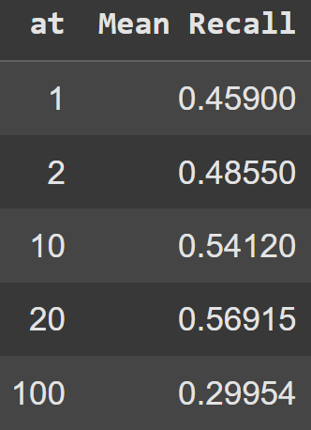
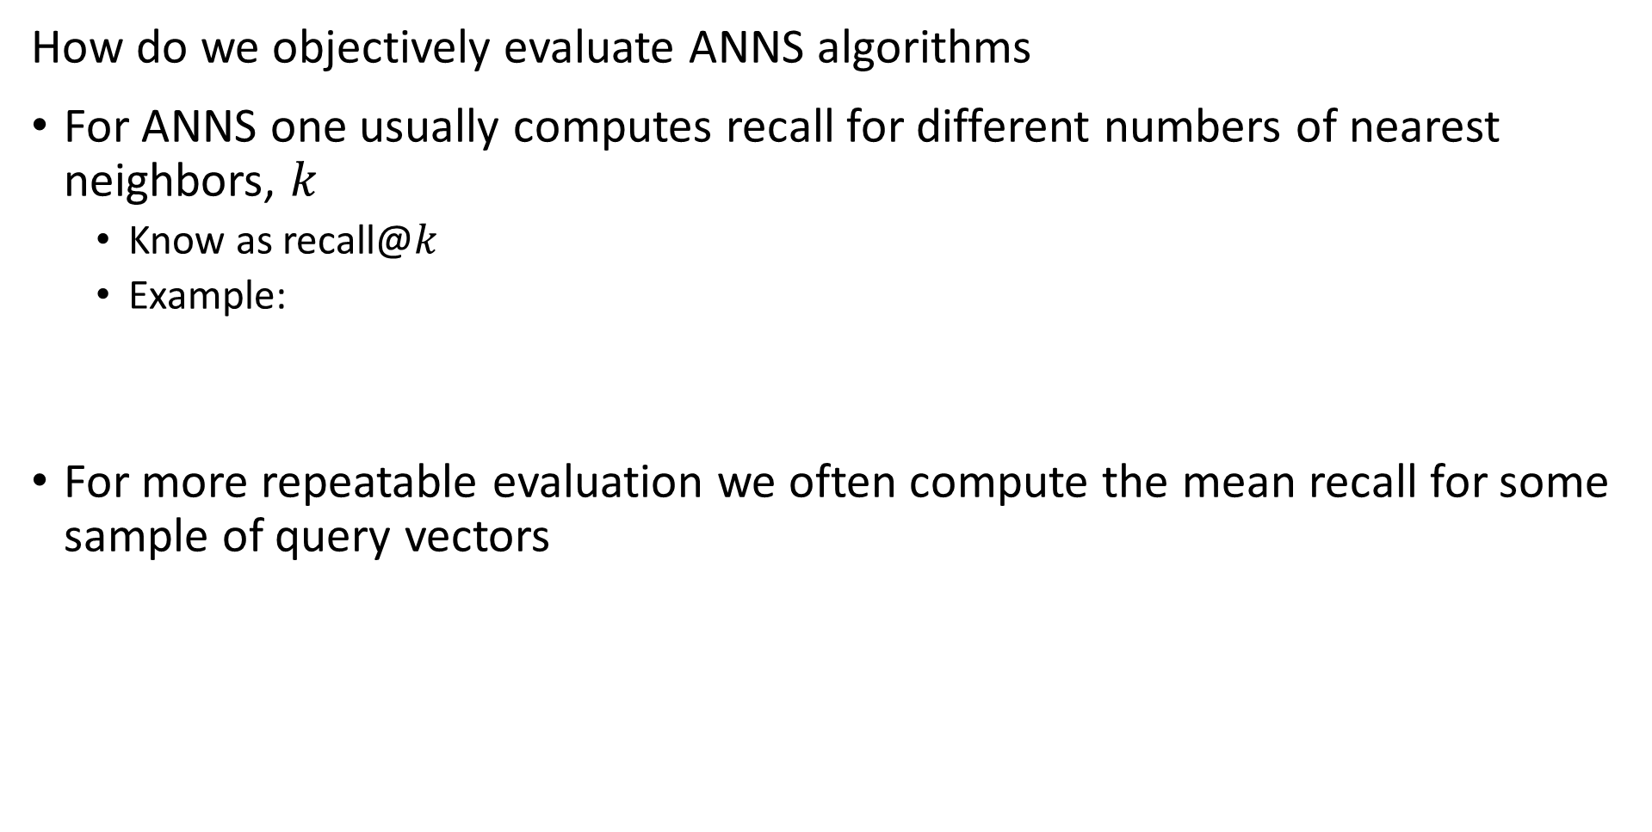
Evaluation of ANNS
How do we objectively evaluate ANNS algorithms
For ANNS one usually computes recall for different numbers of nearest neighbors, $k$
Know as recall@$k$
Example:
For more repeatable evaluation we often compute the mean recall for some sample of query vectors

Slide 17
Evaluation of ANNS
Benchmark datasets for ANNS algorithms

Slide 18
Inverted File Systems

Slide 19
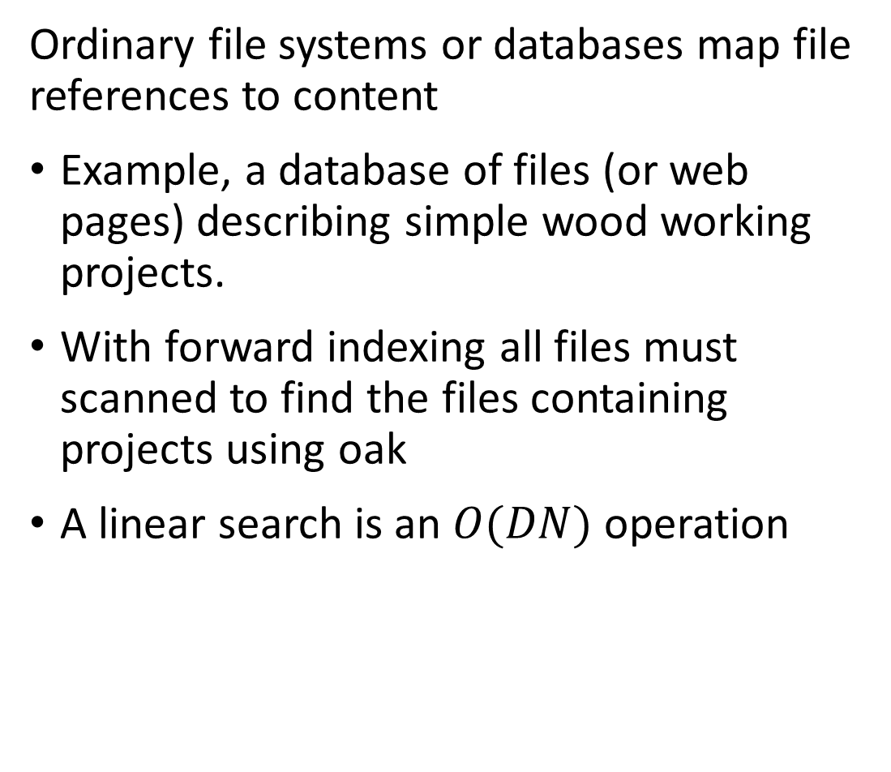
Inverted file systems enable look-up by value
Ordinary file systems or databases map file references to content
Example, a database of files (or web pages) describing simple wood working projects.
With forward indexing all files must scanned to find the files containing projects using oak
A linear search is an $O(DN)$ operation
File ID
101
102
103
104
105
106
107
108
109
110
111
112
113
114
115
Wood type
Oak
Pine
Oak
Maple
Fir
Maple
Fir
Oak
Maple
Fir
Maple
Pine
Maple
Oak
Oak

Slide 20
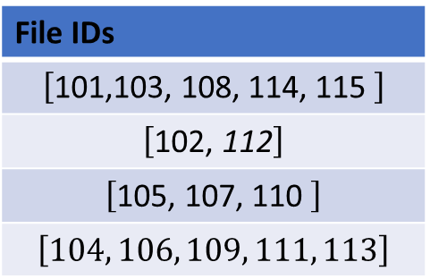
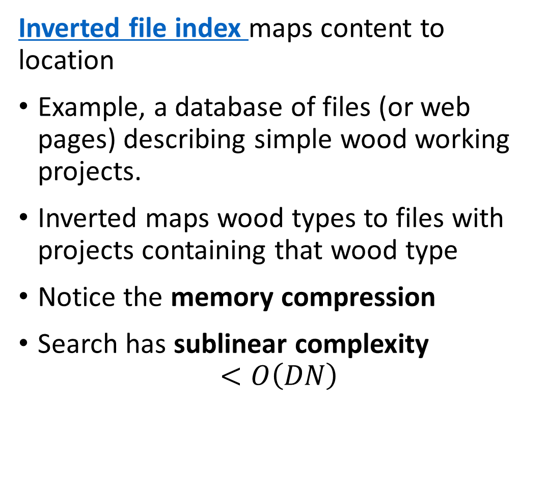
Inverted file systems enable look-up by value
Inverted file index maps content to location
Example, a database of files (or web pages) describing simple wood working projects.
Inverted maps wood types to files with projects containing that wood type
Notice the memory compression
Search has sublinear complexity
$$<O\left(DN\right)$$
Wood type
Oak
Pine
Fir
Maple
File IDs
$$\left[\text{101,}\text{103, }\text{108,} \text{114,} \text{115 }\right]$$
$$\left[\text{10}\text{2}\text{,}\text{ 112}\right]$$
$$\left[\text{10}\text{5}\text{, 1}\text{07}\text{, 11}\text{0} \right]$$
$$\left[104, 106, 109, 111, 113\right]$$

Slide 21
Building KD-Trees

Slide 22
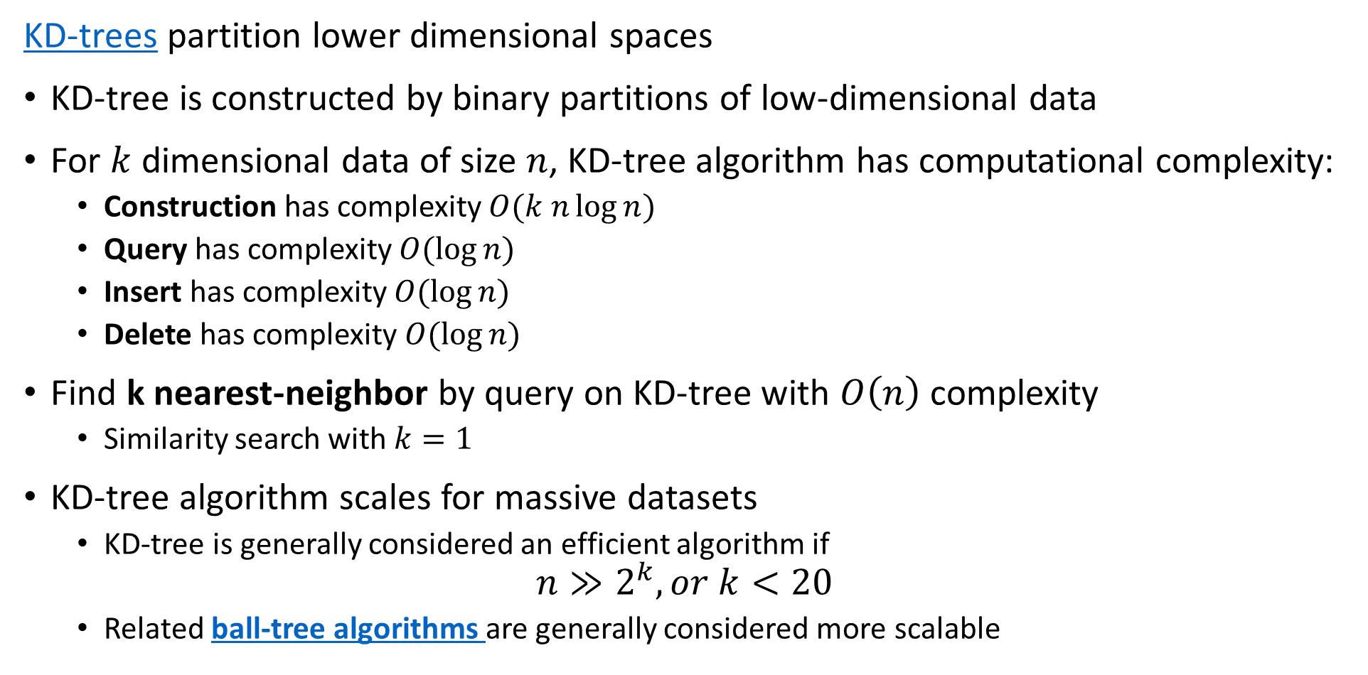
KD-Trees
KD-trees partition lower dimensional spaces
KD-tree is constructed by binary partitions of low-dimensional data
For $k$ dimensional data of size $n$, KD-tree algorithm has computational complexity:
Construction has complexity $O(k n\log{n})$
Query has complexity $O(\log{n})$
Insert has complexity $O(\log{n})$
Delete has complexity $O(\log{n})$
Find k nearest-neighbor by query on KD-tree with $O\left(n\right)$ complexity
Similarity search with $k=1$
KD-tree algorithm scales for massive datasets
KD-tree is generally considered an efficient algorithm if
$$n≫2^{k}, or k<20$$
Related ball-tree algorithms are generally considered more scalable

Slide 23
KD-Trees
A KD-tree is constructed by binary partitions through these steps
Start with the set of observations
Number of observations per leaf is defined – a hyperparameter
Splits are along the axes of the data space
Axes are sampled round-robin or randomly
On each axis split point is determined
Split is on observation closest to median, mean or other measure
Splitting hyperplane is perpendicular to the axis selected
Observations in region split are partitioned left and right of hyperplane
Repeat steps 2-6 until leaf has less than required number of observations
The termination condition

Slide 24
KD-Trees
Many sources discussing details of KD-tree algorithms, their limitations and the pitfalls, with a few suggestions
Chapter from Andrew Moore’s PhD dissertation
Chapters 8, 9, 10, 11 of Advanced Algorithms and Data Structures, Marcello La Rocca, Manning, 2021
Wikipedia article
For a fairly theoretical but comprehensive review paper on approximate nearest neighbor search algorithms see Andoni, Indyk and Razenshteyn, 2018

Slide 25
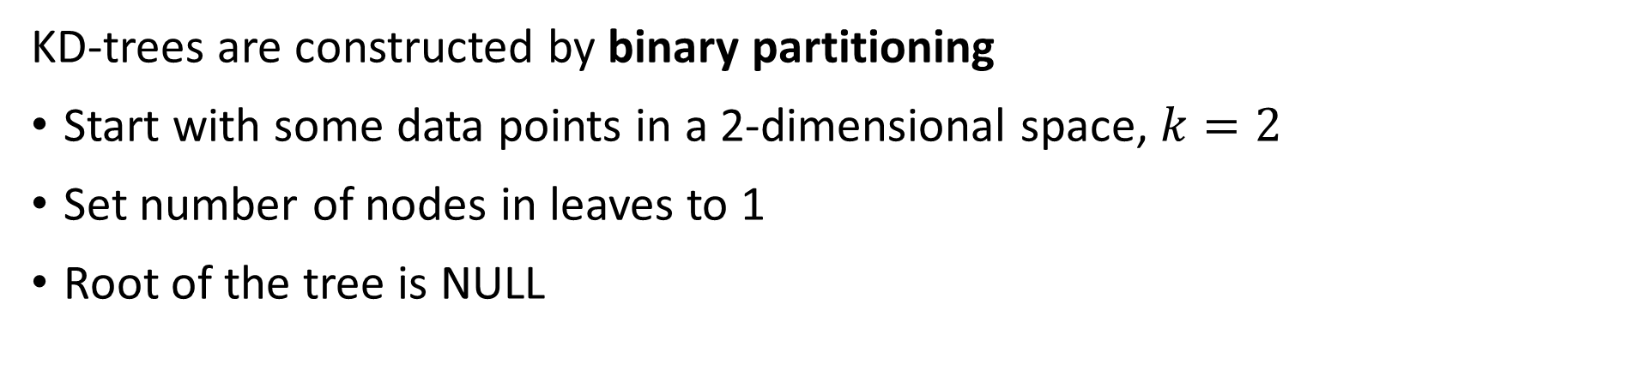
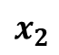
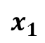
KD-Trees
KD-trees are constructed by binary partitioning
Start with some data points in a 2-dimensional space, $k=2$
Set number of nodes in leaves to 1
Root of the tree is NULL
$$x_{2}$$
A
B
C
J
J
D
E
G
F
I
H
$$x_{1}$$

Slide 26
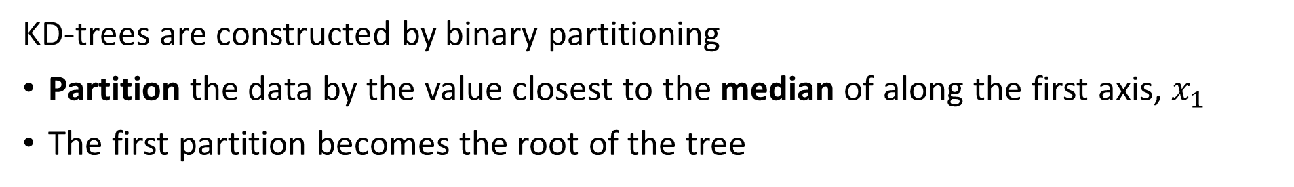
KD-Trees
KD-trees are constructed by binary partitioning
Partition the data by the value closest to the median of along the first axis, $x_{1}$
The first partition becomes the root of the tree
E
$$x_{2}$$
A
B
C
J
J
D
E
G
F
I
H
$$x_{1}$$

Slide 27
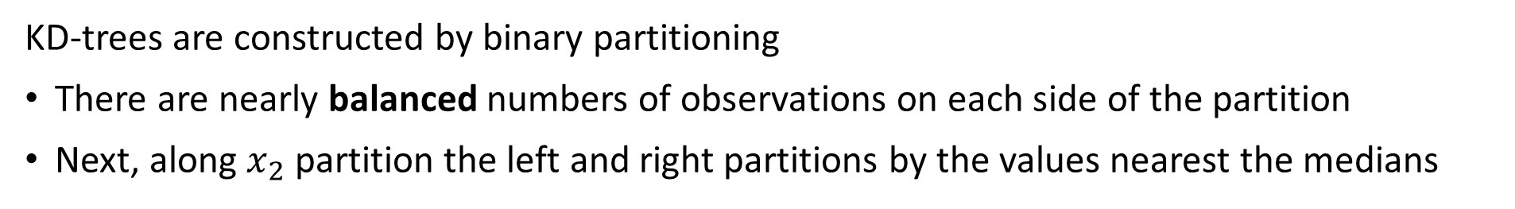
KD-Trees
KD-trees are constructed by binary partitioning
There are nearly balanced numbers of observations on each side of the partition
Next, along $x_{2}$ partition the left and right partitions by the values nearest the medians
E
$$x_{2}$$
A
B
D
G
C
J
J
D
E
G
F
I
H
K
$$x_{1}$$

Slide 28
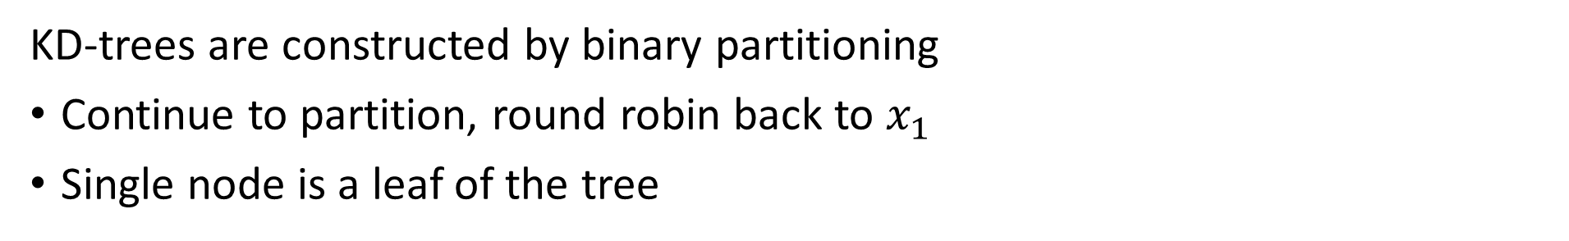
KD-Trees
KD-trees are constructed by binary partitioning
Continue to partition, round robin back to $x_{1}$
Single node is a leaf of the tree
E
$$x_{2}$$
A
B
D
G
C
J
J
J
H
C
K
D
E
G
F
I
H
K
$$x_{1}$$

Slide 29
KD-Trees
KD-trees are constructed by binary partitioning
Now there are only leaves to add to the tree
E
$$x_{2}$$
A
B
D
C
G
J
J
J
H
C
K
D
E
G
A
B
J
F
I
F
I
H
K
$$x_{1}$$

Slide 30
Similarity Queries on KD-Trees

Slide 31
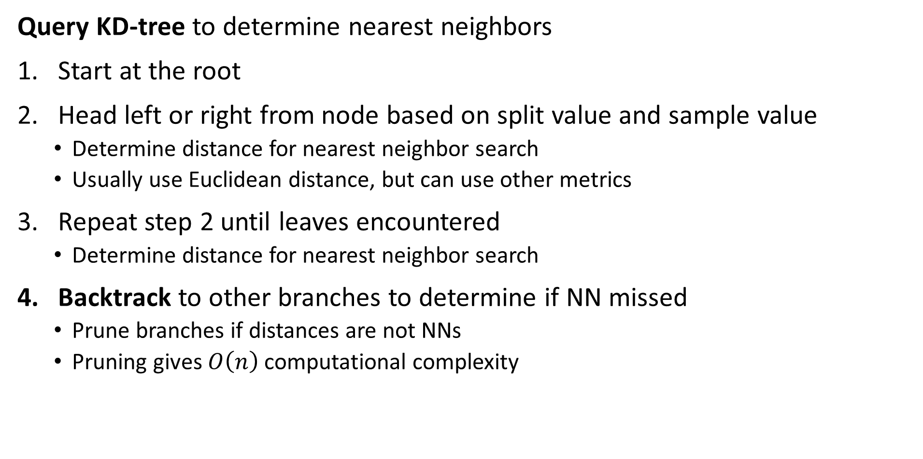
KD-Trees
Query KD-tree to determine nearest neighbors
Start at the root
Head left or right from node based on split value and sample value
Determine distance for nearest neighbor search
Usually use Euclidean distance, but can use other metrics
Repeat step 2 until leaves encountered
Determine distance for nearest neighbor search
Backtrack to other branches to determine if NN missed
Prune branches if distances are not NNs
Pruning gives $O\left(n\right)$ computational complexity

Slide 32
KD-Trees
Can rapidly perform 3-nearest neighbor query a KD-Tree by following the node splits
Start with a new observation, Z
E
$$x_{2}$$
A
B
D
C
G
J
J
J
H
C
K
D
E
G
A
B
J
F
I
F
Z
I
H
K
$$x_{1}$$

Slide 33
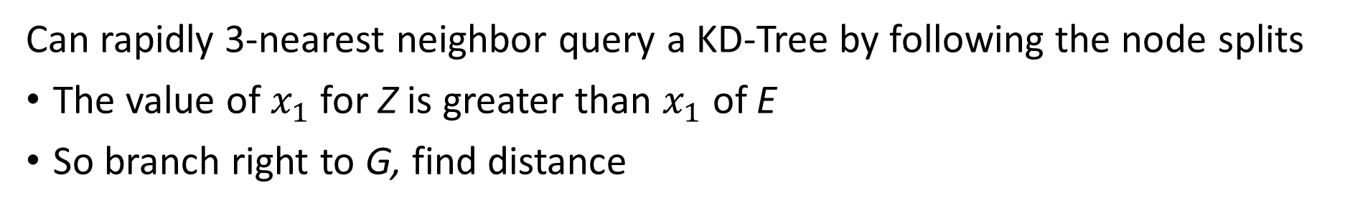
KD-Trees
Can rapidly 3-nearest neighbor query a KD-Tree by following the node splits
The value of $x_{1}$ for Z is greater than $x_{1}$ of E
So branch right to G, find distance
E
$$x_{2}$$
A
B
D
C
G
J
J
J
H
C
K
D
E
G
A
B
J
F
I
F
Z
I
H
K
$$x_{1}$$

Slide 34
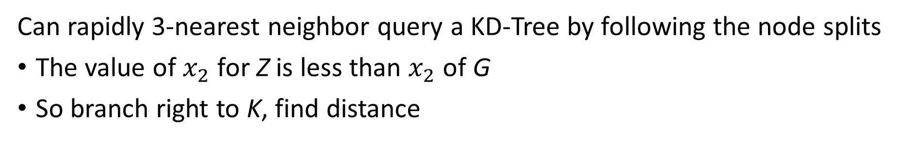
KD-Trees
Can rapidly 3-nearest neighbor query a KD-Tree by following the node splits
The value of $x_{2}$ for Z is less than $x_{2}$ of G
So branch right to K, find distance
E
$$x_{2}$$
A
B
D
C
G
J
J
J
H
C
K
D
E
G
A
B
J
F
I
F
Z
I
H
K
$$x_{1}$$

Slide 35
KD-Trees
Can rapidly 3-nearest neighbor query a KD-Tree by following the node splits
Z has nearest neighbors on graph I, G, K
But is there a nearer neighbor on the graph?
E
$$x_{2}$$
A
B
D
C
G
J
J
J
H
C
K
D
E
G
A
B
J
F
I
F
Z
I
H
K
$$x_{1}$$

Slide 36
KD-Trees
Can rapidly 3-nearest neighbor query a KD-Tree by following the node splits
We need to backtrack to determine if there is a nearer neighbor on another branch
Backtracking to K then to branch with F, finding a nearer neighbor than K
E
$$x_{2}$$
A
B
D
C
G
J
J
J
H
C
K
D
E
G
A
B
J
F
I
F
Z
I
H
K
$$x_{1}$$

Slide 37
KD-Trees
Can rapidly 3-nearest neighbor query a KD-Tree by following the node splits
Continue backtracking to K then to branch to C and J, but no nearer neighbor
We can prune the branch with C and J from the search
E
$$x_{2}$$
A
B
D
C
G
J
J
J
H
C
K
D
E
G
A
B
J
F
I
F
Z
I
H
K
$$x_{1}$$

Slide 38
KD-Trees
Can rapidly query a KD-Tree by following the video splits
The backtrack arrives at the root, terminating the algorithm
E
$$x_{2}$$
A
B
D
C
G
J
J
J
H
C
K
D
E
G
A
B
J
F
I
F
Z
I
H
K
$$x_{1}$$

Slide 39
Coarse Quantization

Slide 40
Coarse quantizaton divides the search region
Coarse quantizatrion speeds NN search by reducing scope
To speed NN search by orders of magnitude limit scope of search
Coarse coding divides the search scope into small cells
Similar vectors are within the cells
Can use the cell ids in an inverted index for fast lookup of similar vectors

Slide 41
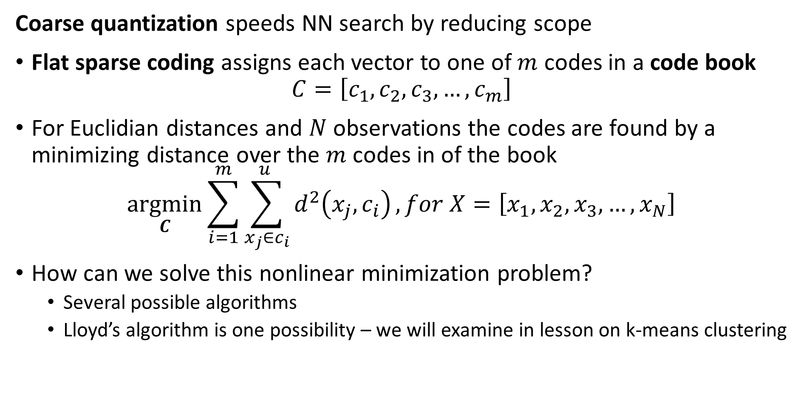
Coarse quantization divides the search region
Coarse quantization speeds NN search by reducing scope
Flat sparse coding assigns each vector to one of $m$ codes in a code book
$$C=\left[c_{1},c_{2},c_{3},…,c_{m}\right]$$
For Euclidian distances and $N$ observations the codes are found by a minimizing distance over the $m$ codes in of the book
$$\underset{C}{argmin}{\sum_{i=1}^{m}{\sum_{x_{j}∈c_{i}}^{u }{d^{2}\left(x_{j},c_{i}\right)}}}, for X=\left[x_{1},x_{2},x_{3},…,x_{N}\right]$$
How can we solve this nonlinear minimization problem?
Several possible algorithms
Lloyd’s algorithm is one possibility – we will examine in lesson on k-means clustering

Slide 42
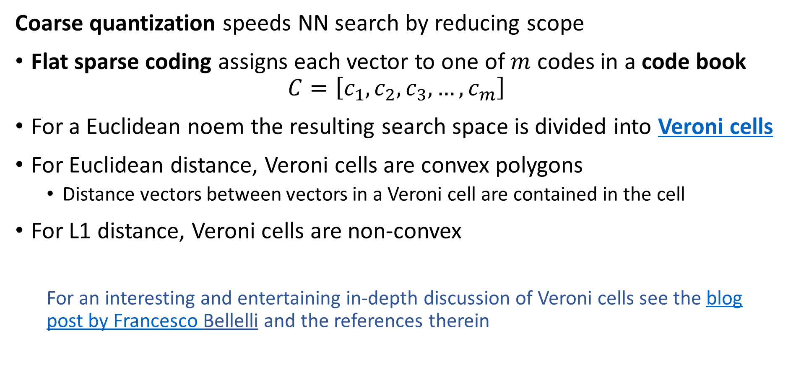
Coarse quantization divides the search region
Coarse quantization speeds NN search by reducing scope
Flat sparse coding assigns each vector to one of $m$ codes in a code book
$$C=\left[c_{1},c_{2},c_{3},…,c_{m}\right]$$
For a Euclidean noem the resulting search space is divided into Veroni cells
For Euclidean distance, Veroni cells are convex polygons
Distance vectors between vectors in a Veroni cell are contained in the cell
For L1 distance, Veroni cells are non-convex
For an interesting and entertaining in-depth discussion of Veroni cells see the blog post by Francesco Bellelli and the references therein

Slide 43
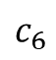
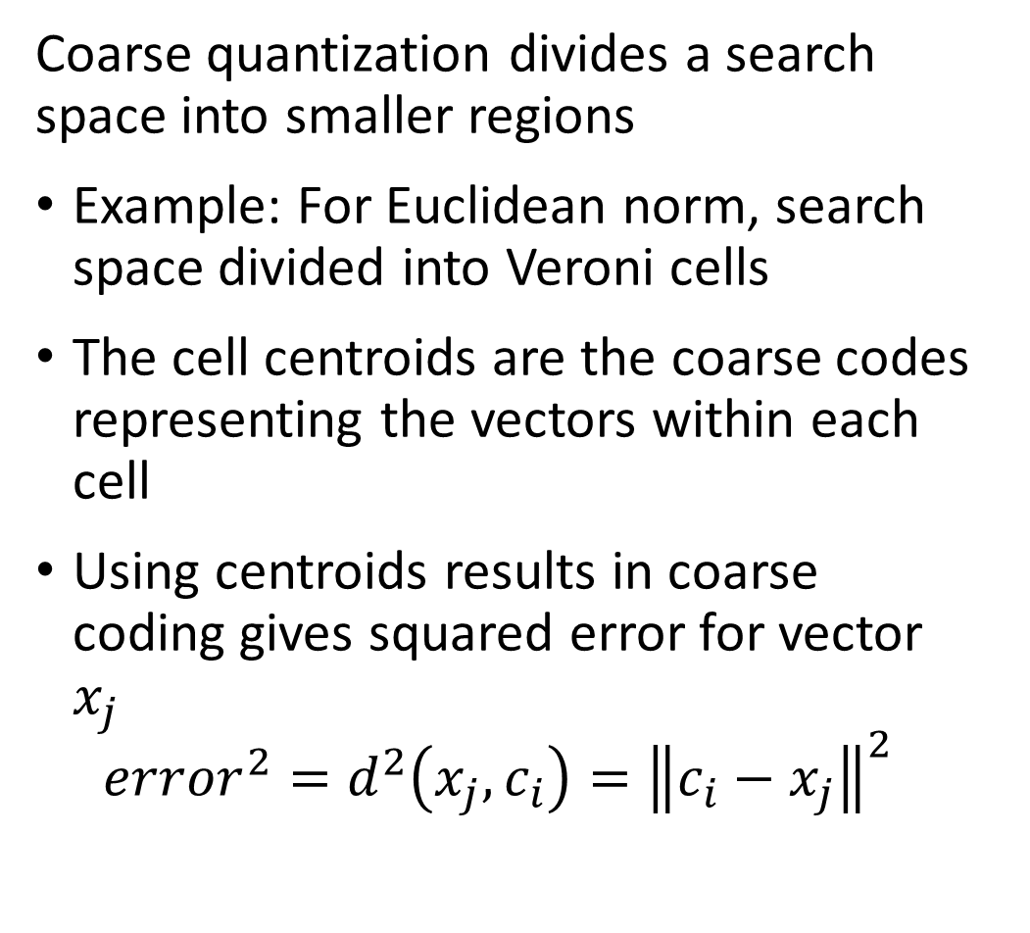
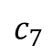
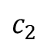
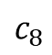
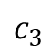
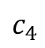
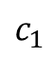
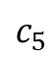
Coarse quantization divides the search region
Coarse quantization divides a search space into smaller regions
Example: For Euclidean norm, search space divided into Veroni cells
The cell centroids are the coarse codes representing the vectors within each cell
Using centroids results in coarse coding gives squared error for vector $x_{j}$
$${error}^{2}=d^{2}\left(x_{j},c_{i}\right)={\left\|c_{i}−x_{j}\right\|}^{2}$$
$$c_{3}$$
$$c_{2}$$
$$c_{7}$$
$$c_{1}$$
$$c_{4}$$
$$c_{8}$$
$$c_{6}$$
$$c_{5}$$

Slide 44
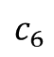
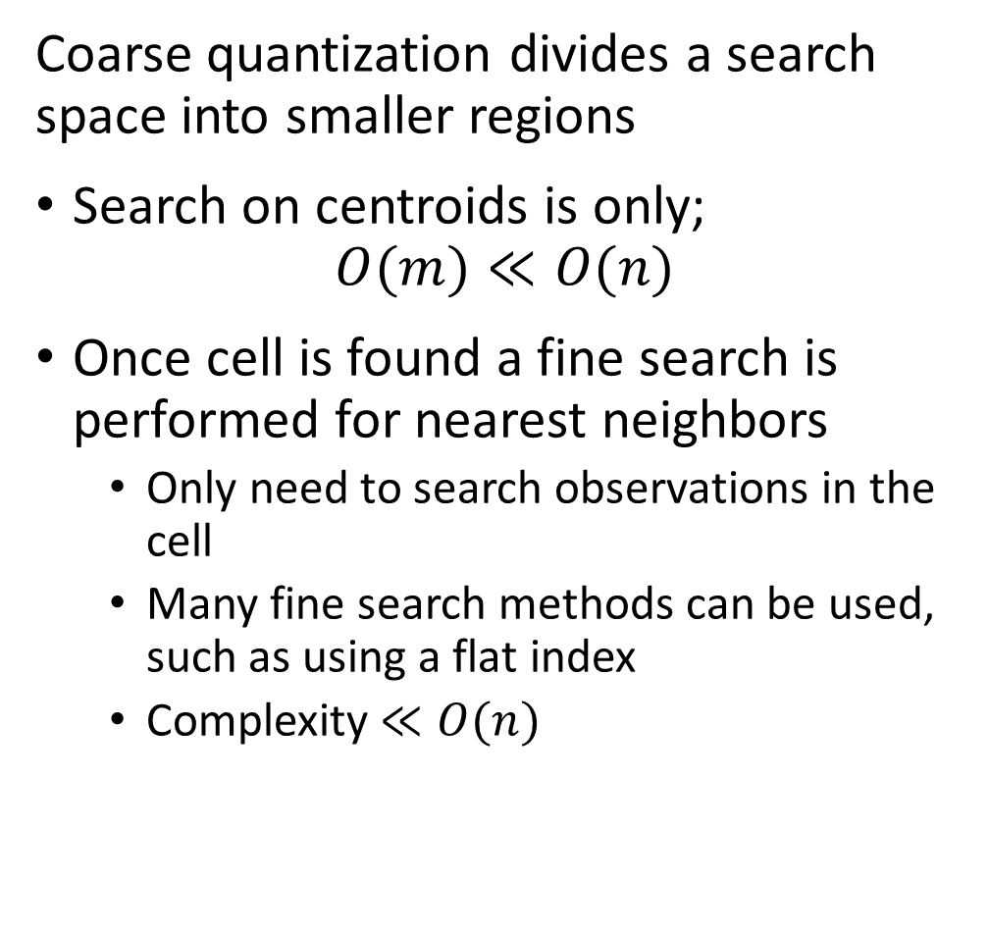
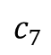
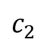
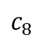
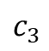
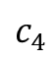
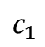
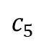
Coarse quantization divides the search region
Coarse quantization divides a search space into smaller regions
Search on centroids is only;
$$O(m)≪O(n)$$
Once cell is found a fine search is performed for nearest neighbors
Only need to search observations in the cell
Many fine search methods can be used, such as using a flat index
Complexity $≪O(n)$
$$c_{3}$$
$$c_{2}$$
$$c_{7}$$
$$c_{1}$$
$$c_{4}$$
$$c_{8}$$
$$c_{6}$$
$$c_{5}$$

Slide 45
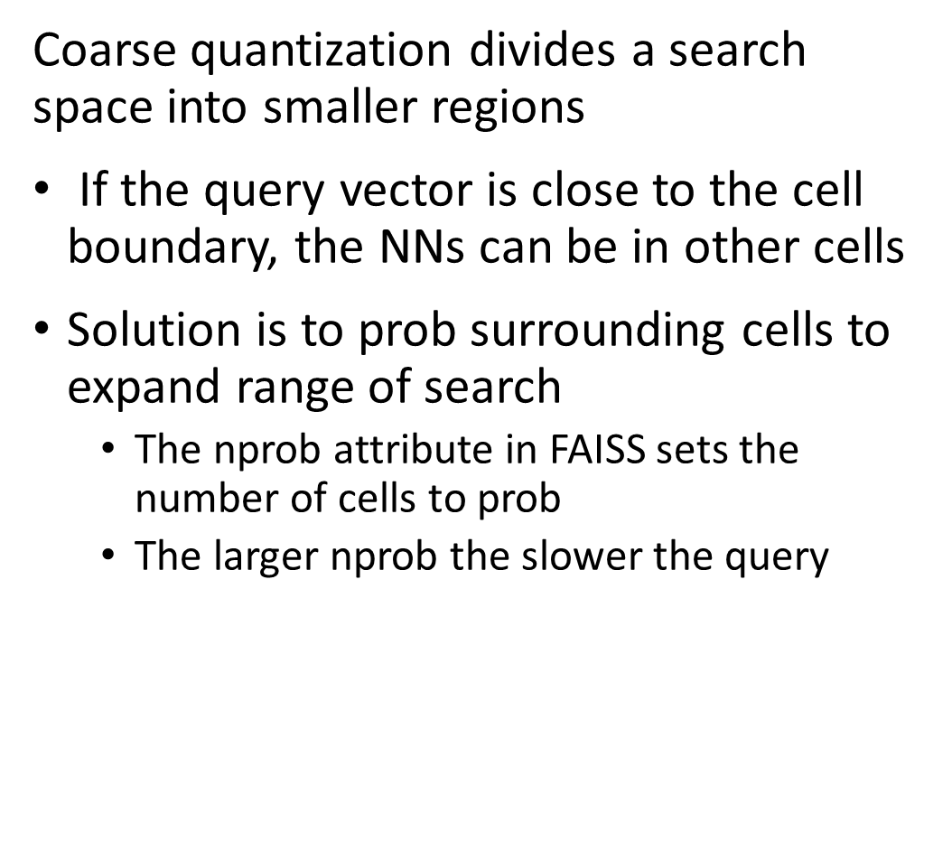
Coarse quantization divides the search region
Coarse quantization divides a search space into smaller regions
If the query vector is close to the cell boundary, the NNs can be in other cells
Solution is to prob surrounding cells to expand range of search
The nprob attribute in FAISS sets the number of cells to prob
The larger nprob the slower the query
$$c_{3}$$
$$c_{2}$$
query
$$c_{7}$$
$$c_{1}$$
$$c_{4}$$
$$c_{8}$$
$$c_{6}$$
$$c_{5}$$

Slide 46
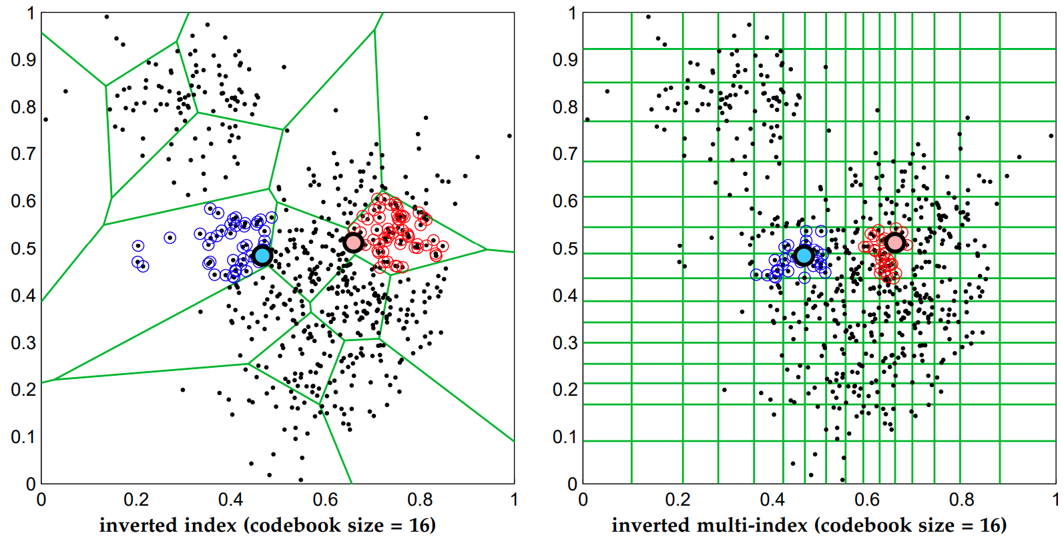
Coarse quantization divides the search region
Veroni cells are not the only way to perform coarse quantization
Babenko, et. al., 2012, proposed using a multi-dimensional inverted multi-index
The multi-index is quantized along the axes of a grid
Result is a better constrained search region

Slide 47
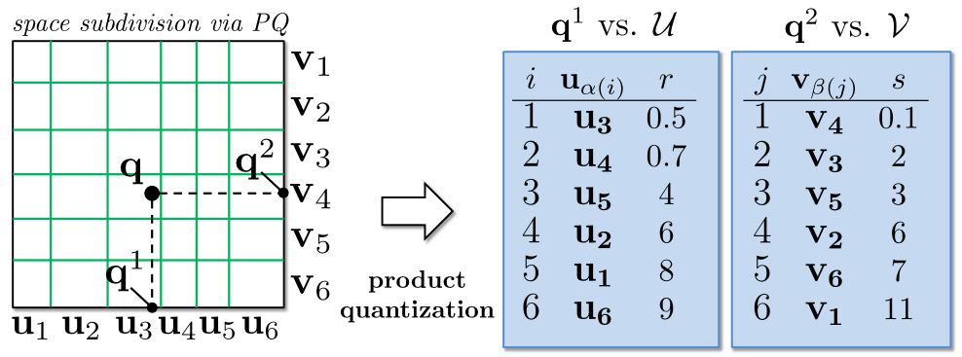
Coarse quantization divides the search region
Babenko, et. al., 2012, proposed using a multi-dimensional inverted multi-index
Grid is quantized along axes
Distances from the query vector are measured along the axes

Slide 48
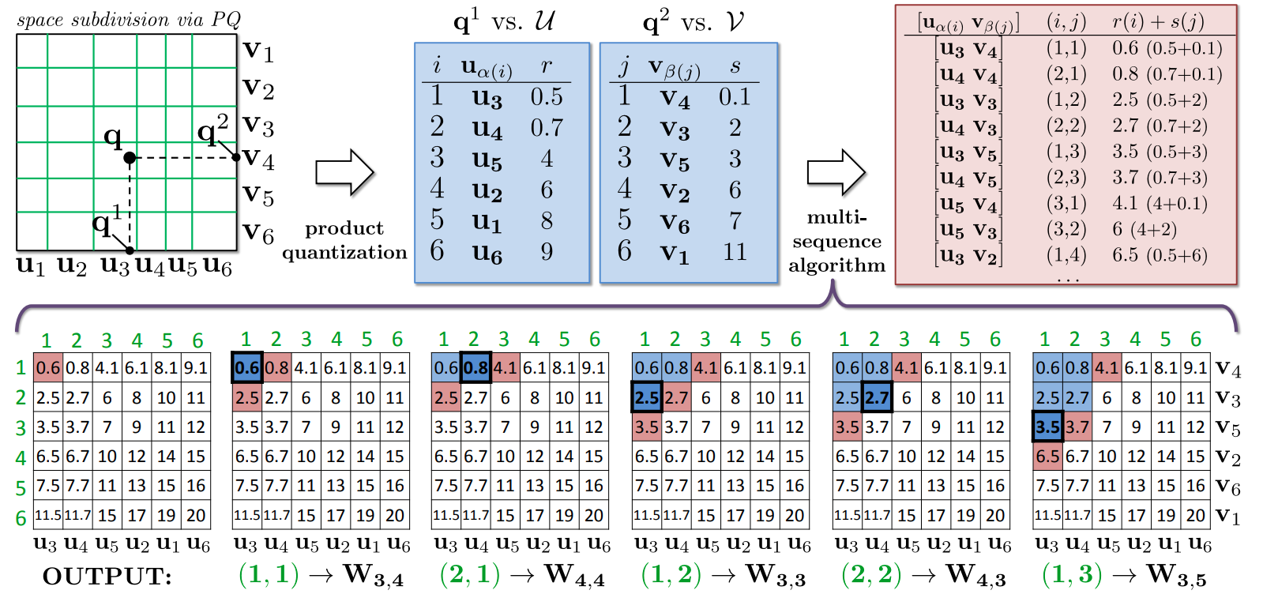
Coarse quantization divides the search region
Babenko, et. al., 2012, proposed using a multi-dimensional inverted multi-index
Total distances are the sum of distances along the axes
The query proceeds stepwise until required NNs found

Slide 49
Product Quantization

Slide 50
Product Quantization
Product Quantization (PQ) for ANNS was first proposed by Jégou, Douze, and Schmid, 2011
Factor observation vectors into subvectors
Factor query vectors into subvectors
Find codes (centroids) by K-means clustering subvectors
Build asymmetric distance tables between subvector centroids and query subvectors
Encode observations subvectors as cluster centroids
Use distance table for NN search for query subvectors
compute distances by summing subvector distances
Database construction
a.k.a. model training
NN search for query

Slide 51
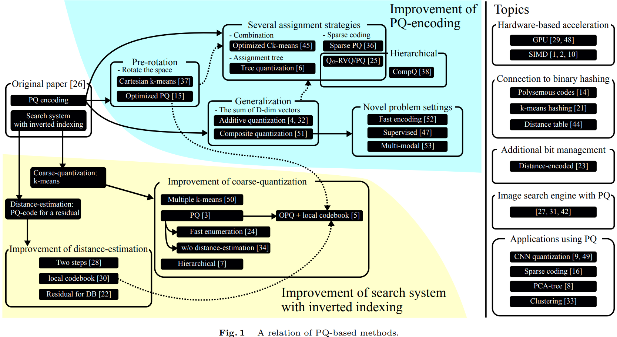
Product Quantization
The review paper by Matsui, et. al., 2018, includes a diagram showing the evolution of PQ algorithms
We will only discuss some of these many algorithms and applicationsin our lesson

Slide 52
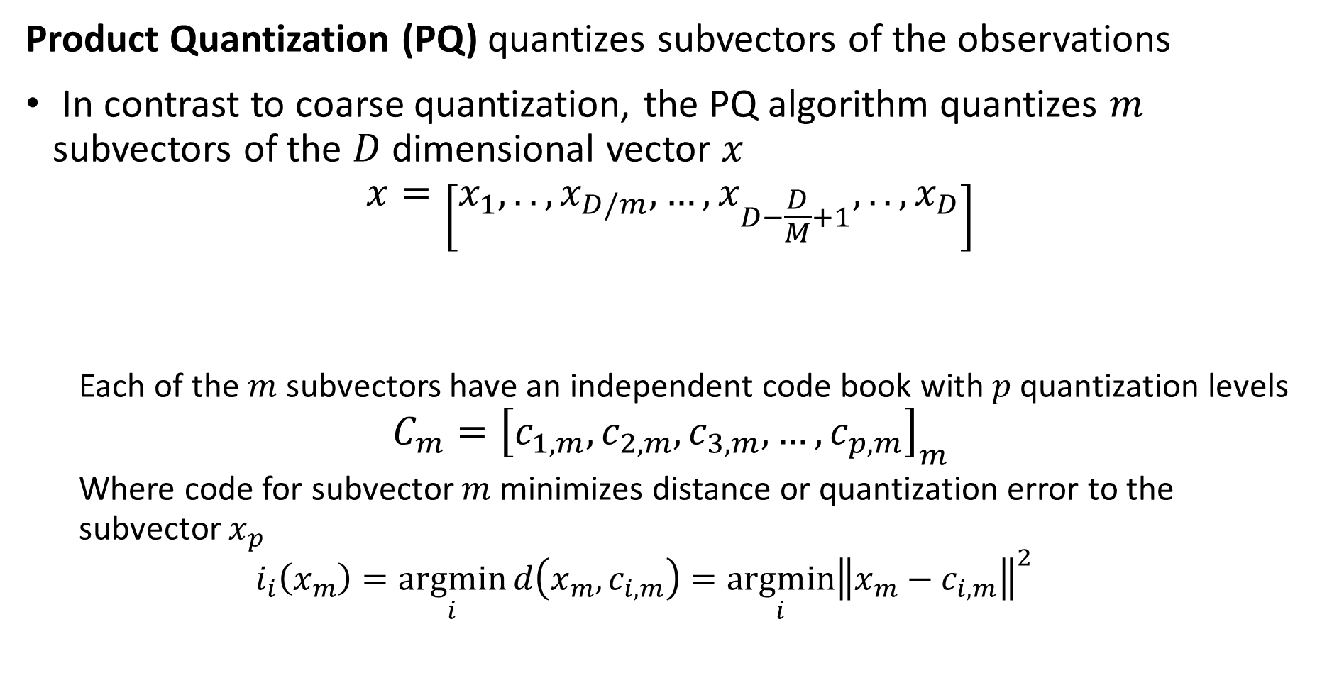
Product Quantization
Product Quantization (PQ) quantizes subvectors of the observations
In contrast to coarse quantization, the PQ algorithm quantizes $m$ subvectors of the $D$ dimensional vector $x$
$$x=\left[x_{1},..,x_{D/m},…,x_{D−\frac{D}{M}+1},..,x_{D}\right]$$
Each of the $m$ subvectors have an independent code book with $p$ quantization levels
$$C_{m}={\left[c_{1,m},c_{2,m},c_{3,m},…,c_{p,m}\right]}_{m}$$
Where code for subvector $m$ minimizes distance or quantization error to the subvector $x_{p}$
$$i_{i}\left(x_{m}\right)=\underset{i}{argmin}{d\left(x_{m}, c_{i,m}\right)}=\underset{i}{argmin}{{\left\|x_{m}−c_{i,m}\right\|}^{2}}$$
Subvector 1
Subvector p

Slide 53
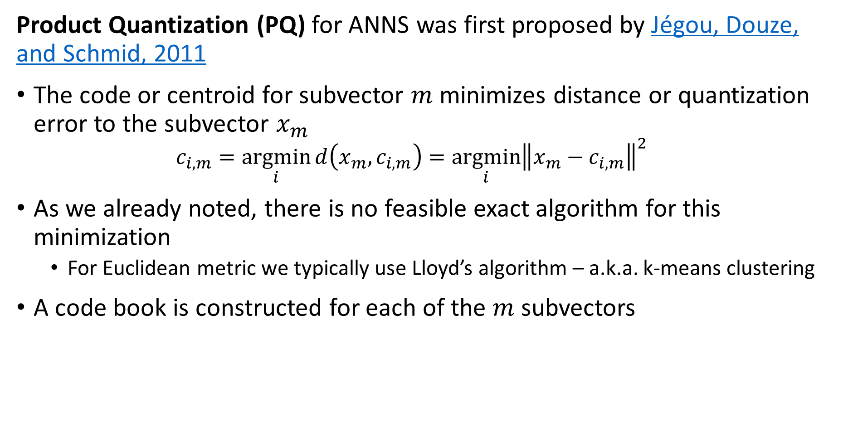
Product Quantization
Product Quantization (PQ) for ANNS was first proposed by Jégou, Douze, and Schmid, 2011
The code or centroid for subvector $m$ minimizes distance or quantization error to the subvector $x_{m}$
$$c_{i,m}=\underset{i}{argmin}{d\left(x_{m}, c_{i,m}\right)}=\underset{i}{argmin}{{\left\|x_{m}−c_{i,m}\right\|}^{2}}$$
As we already noted, there is no feasible exact algorithm for this minimization
For Euclidean metric we typically use Lloyd’s algorithm – a.k.a. k-means clustering
A code book is constructed for each of the $m$ subvectors

Slide 54
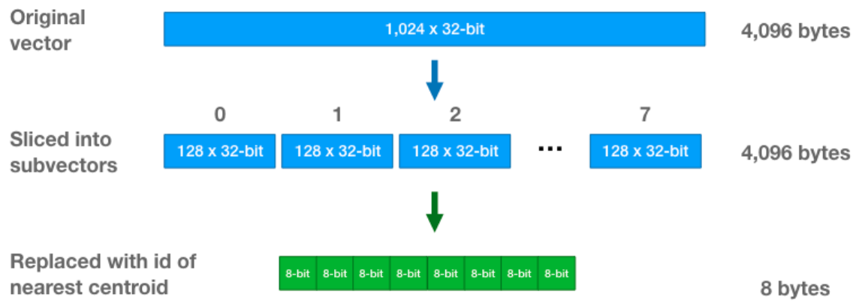
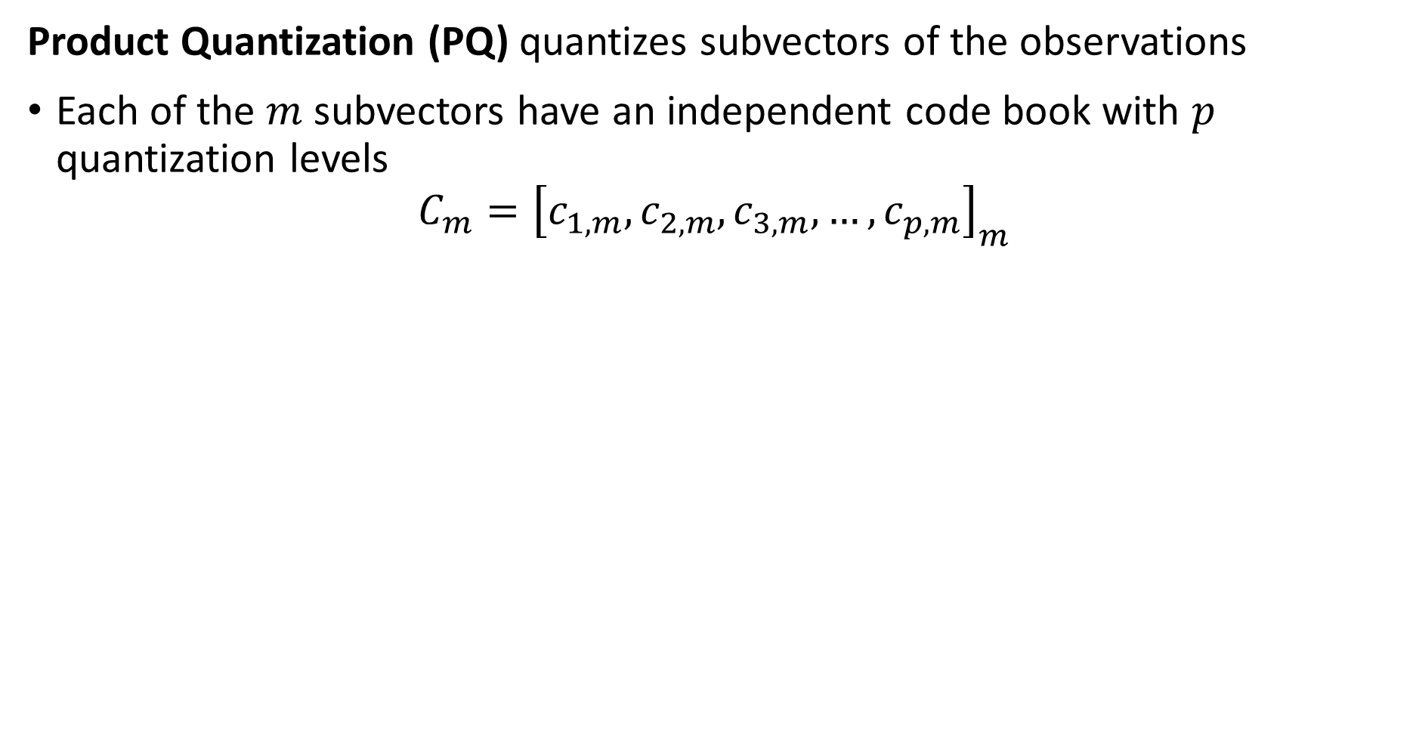
Product Quantization
Product Quantization (PQ) quantizes subvectors of the observations
Each of the $m$ subvectors have an independent code book with $p$ quantization levels
$$C_{m}={\left[c_{1,m},c_{2,m},c_{3,m},…,c_{p,m}\right]}_{m}$$
Example from Chris McCormick’s blog post on the PQ algorithm

Slide 55
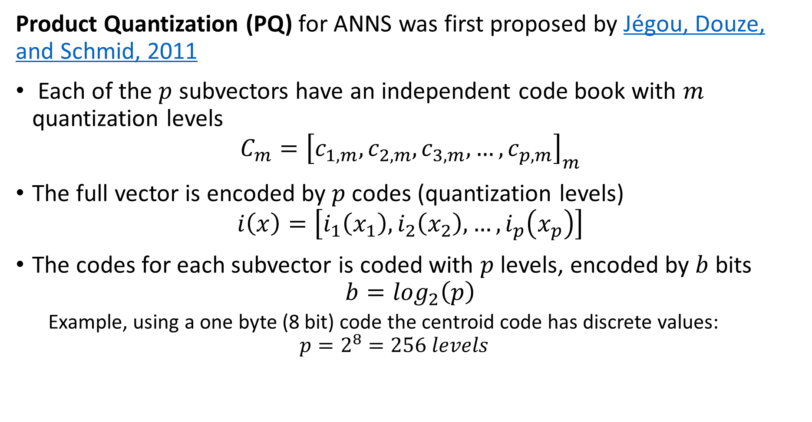
Product Quantization
Product Quantization (PQ) for ANNS was first proposed by Jégou, Douze, and Schmid, 2011
Each of the $p$ subvectors have an independent code book with $m$ quantization levels
$$C_{m}={\left[c_{1,m},c_{2,m},c_{3,m},…,c_{p,m}\right]}_{m}$$
The full vector is encoded by $p$ codes (quantization levels)
$$i\left(x\right)=\left[i_{1}\left(x_{1}\right),i_{2}\left(x_{2}\right),…,i_{p}\left(x_{p}\right)\right]$$
The codes for each subvector is coded with $p$ levels, encoded by $b$ bits
$$b=\log_{2}\left(p\right)$$
Example, using a one byte (8 bit) code the centroid code has discrete values:
$$p=2^{8}=256 levels$$

Slide 56

Product Quantization
Product Quantization (PQ) for ANNS was first proposed by Jégou, Douze, and Schmid, 2011
PQ coding is invertible, $i^{−1}$, so we can approximately reconstruct the original vector
$$x≈\tilde{x}=i^{−1}\left(x_{i}\right)=i^{−1}\left[\begin{matrix}x_{1} \\ x_{2} \\ \begin{matrix}⋮ \\ x_{p}\end{matrix}\end{matrix}\right]=\left[\begin{matrix}c_{1,m} \\ x_{2,m} \\ \begin{matrix}⋮ \\ x_{p,m}\end{matrix}\end{matrix}\right]$$

Slide 57



Product Quantization
Product Quantization (PQ) is memory efficient
The complete code book for each subvector, $A$, is represented by a $N×p$ array
Example, with $p=256$ the full code book is an $N×256$ array
Example of compression
Vector length, $D=1024$, memory for float
$=4×8×1024=32768$ bits
Number of subvectors, $m=8$
Number of code levels, $p$, with $b=8{⟶p=2}^{8}=256$ levels
Total codes per vector, $m×2^{b}=8×256=2048$
Compression factor $=\frac{32768}{8×8}=512$
$$m$$
0 ,0
0 ,1
. . .
0 ,k-1
1 ,0
1 ,1
. . .
1 ,k-1
2 ,0
2 ,1
. . .
2 ,k-1
3 ,0
3 ,1
. . .
3 ,k-1
$$N$$
.
.
.
.
.
.
.
.
.
N-2 ,0
N-2 ,1
. . .
N-2 ,k-1
N-1,0
N-1,1
. . .
N-1,k-1

Slide 58



Product Quantization
Product Quantization (PQ) queries use asymmetric distance (ASD) calculations
A naïve algorithm for PQ ANNS requires expanding the compressed vectors
This process is invertible and is therefore symmetric
ASD provides an efficient look-up method for ANNS
For the ASD algorithm distances are computed between the $m$ subvectors of the query, $q$, and the subvectors of the $p$ centroids, $c_{i}$
This process is not investable and is therefore asymmetric
The result is a lookup table of dimension $p×m$
NN search on the lookup table is fast
$$m$$
0 ,0
0 ,1
. . .
0 ,-1
1 ,0
1 ,1
. . .
1 ,m-1
2 ,0
2 ,1
. . .
2 ,m-1
$$p$$
3 ,0
3 ,1
. . .
3 ,m-1
.
.
.
.
.
.
.
.
.
k-2 ,0
N-2 ,1
. . .
k-2 ,m-1
k-1,0
N-1,1
. . .
k-1,k-1

Slide 59

Performance of the PQ algorithm
The PQ algorithm has two key hyperparameters
$m$: increasing the number of subvectors decreases the quantization error
As the number of subvectors increases the size of the code book increases
As the number of subvectors increases the computational complexity increases
$p$, increasing the number of quantization levels decreases the quantization error
As the number of quantization levels increases the size of the code book increases
As the number of quantization levels increases the computational complexity increases
Low Memory -Scalable
Increasing p and m
Increasing p and m
Low Computational Complexity-Scalable
High Recall -Accuracy

Slide 60

Improving Basic Quantization
Quantization algorithms can be formulated in terms residuals
We can perform similarity search using differences or residuals with respect to the centroid
Idea proposed by Schicong, et.al., 2015, and others
Example from Chris McCormick’s blog post on the PQ algorithm

Slide 61

Improving Basic Quantization
Quantization algorithms can be formulated in terms residuals
We can perform similarity search using differences or residuals with respect to the centroid
Consider the Euclidean distance calculation between a query vector, $q$, and another vector, $x$, with centroid, $c$, with dimension $D$
$$d^{2}\left(x−c,q−c\right)=\sum_{i=1}^{D}{{\left[\left(x_{i}−c_{i}\right)−\left(q_{i}−c_{i}\right)\right]}^{2}=\sum_{i=1}^{D}{{\left[x_{i}−q_{i}\right]}^{2}}=d^{2}\left(x,q\right)}$$
Computing distances with just residuals has no advantage, so why bother?

Slide 62

Improvements Basic Product Quantization
Quantization algorithms can be formulated in terms residuals
What is the advantage of using residuals, since we get the same result either way?
The variance of the residuals, and therefore the error of distance estimates is reduced!
Using residuals for distance estimates are zero-centered, analogous to zero-centering variables for machine learning
Example from Chris McCormick’s blog post on the PQ algorithm

Slide 63

Improvements Basic Product Quantization
Optimized product quantization (OPQ) was proposed by $Ge, et. al., 2013$
The PQ algorithm assumes the subvectors are uncorrelated or orthogonal
OPQ adds an orthogonalization step before PQ is applied
Apply the orthogonal Procrustes problem to transform the data matrix $X$ to an orthogonal matrix $\tilde{X}$
$$\min_{R}{{\left\|RX−\tilde{X}\right\|}_{F}, S.T. R^{T}R=I }$$
Where, ${\left\|.\right\|}_{F}$ is the Forbenious (Euclidean matrix) norm
Orthogonalization is applied iteratively at each step of the PQ algorithm
OPQ often improves recall at minimal computational cost
OPQ can reduce dimensions

Slide 64

Product Quantization as a Refinement
The PQ algorithm can be used to refine searches following coarse quantization
Idea introduced by Jegou, et. al., 2011
Coarse quantization is efficient in memory and computation
PQ is applied only to cells being probed
Concatenating these algorithms provides improved recall with low memory use and computational complexity
Figure from Jegou, et. al., 2011

Slide 65
Hierarchical Navigable Small World (HNSW) Graphs

Slide 66
Hierarchical Navigable Small World Graphs
Hierarchical navigable small world (HNSW) graphs for ANNS where first proposed for ANNS by Malkov and Yashunin, 2011
A HNSW graph performs an ANNS on a hierarchy of graphs in two greedy search steps
Search through hierarchy from top to bottom with increasing detail, ‘zooming in’
Search at most detailed level, ‘zooming out’
HNSW graphs incorporate several concepts
Proximity graphs
Probabilistic hierarchical search
Navigable small world graphs

Slide 67
Hierarchical Navigable Small World Graphs
Hierarchical navigable small world (HNSW) graphs for ANNS where first proposed for ANNS by Malkov and Yashunin, 2011
Start search by selecting node in top layer
Find nearest neighbor to the query vector in the top layer
Zoom In
Use nearest neighbor from previous layer as starting point
Search next layer for nearest neighbor
Use nearest neighbor from previous layer as starting point
Zoom Out
Search bottom layer for nearest neighbor
Nearest neighbor search on HNSW graph

Slide 68
Hierarchical Navigable Small World Graphs
Hierarchical navigable small world (HNSW) graphs for ANNS where first proposed for ANNS by Malkov and Yashunin, 2011
A HNSW graph performs an ANNS on a hierarchy of graphs in two greedy search steps
Search through hierarchy from top to bottom with increasing detail, ‘zooming in’
Search at most detailed level, ‘zooming out’
HNSW graphs incorporate several concepts
Proximity graphs
Navigable small world graphs
Probabilistic hierarchical search

Slide 69


Proximity Graphs
Nearest neighbor (NN) graphs are an example of proximity graphs
Presentence of edges in a proximity graph (index) determined by distance or similarity between nearest neighbors
Searches on a proximity graph finds $k$ nearest neighbors
Notice that nodes must have number of edges $m>k$ for search to succeed
You can find more detail on proximity graphs in a number of sources, including Mengzhao Wang’s blog post
Diagram credit, Mengzhao Wang

Slide 70


Navigable Small World Graphs
Navigable small world (NSW) graphs are defined as having high clustering coefficients and distance growing as $O(\log\left(n\right))$
A small world graph exhibits high association between nodes resulting from high clustering
NSW graphs have both short-range connections between near neighbors and long-range connections

Slide 71


Navigable Small World Graphs
Navigable small world (NSW) graphs are a form of proximity graph
Connectivity determined by number of edges per node ($M$ in FAISS or $p$ in NetworkX)
As the $M⟶N$ the proximity graph becomes fully connected
Clustering coefficient increases and average distance decreases as average number of connections per node increase

Slide 72


Navigable Small World Graphs
Navigable small world (NSW) graphs are defined as having high clustering coefficients and distance growing as $O(\log\left(n\right))$
Clustering coefficient increases and average distance decreases as average number of long-range connections ($q$ in NetworkX) per node increase
NSW graphs have relatively few hub nodes with high degree compared to other nodes

Slide 73
Hierarchical Navigable Small World Graphs
Hierarchical Navigable small world (HNSW) graphs enable efficient and scalable ANNS
Malkov, et. al., 2014 applied NSW graphs to the ANNS problem
In some cases, a greedy search on a NSW effectively finds the NNs
If the graph exhibits considerable clustering only a sub-optimal local solution will be found
In other cases the search path can be long
Using a hierarchy of NSW graphs is more robust and helps to overcome these problems

Slide 74

Hierarchical Navigable Small World Graphs
Hierarchical Navigable small world (HNSW) graphs enable efficient and scalable ANNS
The hierarchy of NSW graphs creates a skip list
Skip-list search was introduced by Pugh, 1990, as a fast search algorithm
A skip-list is a form of linked list using a hierarchy of long-range and short-range links
Links connecting observations are sampled probabilistically
Diagram credit, Pugh, 1990

Slide 75

Hierarchical Navigable Small World Graphs
Hierarchical Navigable small world (HNSW) graph has $m$ layers comprised of NSW graphs of increasing resolution
The highest level of the hierarchy has the longest-range edges
The search proceeds to increasingly finer detail levels
The lowest level contains all nodes and the most detail
query
Level 2
query
Level 1
query
Level 0

Slide 76

Hierarchical Navigable Small World Graphs
Hierarchical Navigable small world (HNSW) graph has $m$ layers comprised of NSW graphs of increasing resolution
The search at the highest level begins at an chosen entry node
The graph is traversed in a greedy manner until the node closest to the query is found
Searches at subsequent levels are the ‘zoom in’ phase of the search
query
Level 2

Slide 77

Hierarchical Navigable Small World Graphs
Hierarchical Navigable small world (HNSW) graph has $m$ layers comprised of NSW graphs of increasing resolution
The NN node at the previous level is used as the entry point for a greedy search at the next level of the hierarchy
Greedy search at next level of detail finds next NN node
The foregoing steps are repeated until bottom level is reached
query
Level 2
query
Level 1

Slide 78

Hierarchical Navigable Small World Graphs
Hierarchical Navigable small world (HNSW) graph has $m$ layers comprised of NSW graphs of increasing resolution
The NN node at the previous level is used as the entry point for a greedy search at the lowest level of the hierarchy
Greedy search at the lowest level is has full detail, finding NN nodes
The lowest level search is the ‘zoom out’ phase
query
Level 2
query
Level 1
query

Slide 79

Constructing NSW Graphs
The construction process for HNSW graphs is similar to the query process
A hierarchical NN search is used to find the location of the new element on the HNSW graph
The level of the new element is determined by probabilistically sampling from an exponential decay distribution over levels, $\left[0, 1,…, M\right]$
$P\left[0\right]>uniform(0,1)$
$P\left[1\right]>uniform\left(0,1\right)−P\left[0\right]$
$P\left[2\right]>uniform\left(0,1\right)−P\left[1\right]$
…
else, $M−1$
Notice the rapid decay of this distribution $P\left[0\right]≫P\left[1\right]≫P\left[2\right]≫…$
Detail increases rapidly with depth in the hierarchy, improving search speed

Slide 80
Optimizing HNSW graph
The HNSW ANNS has several hyperparameters that affect performance
M determines the number of edges each node in the graph has.
Limits are set by M_max and M_max0 limit the number of edges in the layers and in the bottom layer, 0, with defaults M_max = M and M_max0 = 2*M
efConstruction sets the number of entry points used when building the index
efSearch sets the number of entry points used for the NN search

Slide 81
Optimizing HNSW ANNS
Low Memory -Scalable
The HNSW ANNS has several hyperparameters that affect performance
M determines the number of edges each node in the graph has.
Limits are set by M_max and M_max0 limit the number of edges in the layers and in the bottom layer, 0, with defaults M_max = M and M_max0 = 2*M
efConstruction sets the number of entry points used when building the index
efSearch sets the number of entry points used for the NN search
Increasing M
Increasing M and ef’s
Low Computational Complexity-Scalable
High Recall -Accuracy

Slide 82

Optimizing HNSW graph
The HNSW ANNS has several hyperparameters that affect performance
ANNS on HNSW can achieve high recall but at a price

Slide 83

Optimizing HNSW graph
The HNSW ANNS has several hyperparameters that affect performance
Achieving higher recall with HNSW ANNS increases search time significantly

Slide 84

Optimizing HNSW graph
The HNSW ANNS has several hyperparameters that affect performance
Achieving higher recall with HNSW ANNS increases memory consumption significantly

Slide 85
Concatenating Indices

Slide 86
Concatenating Indices
For optimal ANNS performance multiple indices are concatenated
While single indices can achieve good recall, it is unreasonable to expect optimal performance
Optimal performance is obtained by concatenating indices
Distance (Similarity) Metric
Dimensionality Reduction (Embedding)
Create D dimensional numeric embedding vectors
PCA
Neural Embedding
Etc.
Coarse Quantization
Reduce scope for ANN search
Inverted file - IVF
IVF Product quantization (IVF-PQ)
Inverted Multi-Index (IMI)
IVF Hierarchical Navigable Small Worlds (HNSW)
Etc…
Fine Quantizaton
Further reduce search scope and improve recall
Exhaustive search – Flat
Residual PQ
Locally Sensitive Hashing (LSH)
Search Refinemnet
Increase recall for NN search
Flat
Residual PQ algorithm

Slide 87

Concatenating Indices
For optimal ANNS performance multiple indices are concatenated
The FAISS index factory simplifies creation of concatenated indices
FAISS allows a complex set of choices for concatenated indices

Slide 88

Concatenating Indices
How can we construct effective concatenated indicies?
Be careful! Order maters for concatenated indicies!
Many purmutations do not make sense
Concatenated indices must work from coarse to fine
Example of using FAISS index factory
Dimension of input vector
String specifying concatenated operations
index = index_factory(128,"OPQ32_64,IMI2x8, PQ32x8")
Where:
OPQ16_64: optimized PQ coarse quantizer with $m=16$ and output dimension 64
IMI2x8: inverted multi-index with 2 dismensions and $2^{b}=2^{8}=256$ levels
PQ32x8: PQ fine quantizer with $m=32$ and $2^{b}=2^{8}=256$ levels

Slide 89

Concatenating Indices
For optimal ANNS performance multiple indices are concatenated
nnnn
Table From Part 6 of FAISS the Missing Manual

Slide 90

Concatenating Indices
For optimal ANNS performance multiple indices are concatenated
nnnn
Table From Part 6 of FAISS the Missing Manual

Slide 91
Mini-Hashes and Sketches For Similarity Search

Slide 92

Locally Sensitive Hashing
Locally sensitive hashing (LSH) is a computationally efficient method to measure similarity in high dimensional spaces
LSH algorithms perform approximate similarity search with $O\left(n\right)$ complexity for high dimensional space
LSH algorithms can be applied to categorical and numeric data
Jaccard similarity
Hamming similarity
Euclidean similarity
Cosign similarity
Etc.

Slide 93
Locally Sensitive Hashing
Example, process flow for LSH for document similarity
Goal is to perform similarity search between documents in corpus
Process involves three steps
Similar workflow for images and other content
Document Corpus
Mini-hashing to create sketch
Similarity approximated by LSH
Shingling of document

Slide 94
Locally Sensitive Hashing

Slide 95

Locally Sensitive Hashing
Probability of error from mini-hashing
Consider the Jaccard similarity between two documents:
${sim}_{Jaccard}\left(s_{i},s_{j}\right)=s$
The probability that all $r$ mini-hashes agree is: $s^{r}$
The probability that at least 1 of the mini-hashes disagree: $1−s^{r}$

Slide 96

Locally Sensitive Hashing
Probability of error from mini-hashing
The probability that all $r$ mini-hash signatures agree is: $s^{r}$
The probability that at least 1 of the mini-hashes disagree: $1−s^{r}$
For $r=5$ we see the following sensitivity of the decision function:
The sensitivity to positive cases is low, poor sensitivity to discoveries!
S | Probability Positive | Probability Negative | Expected Positive Pairs per 1000
0.1 | 1.0000E-05 | 9.9999E-01 | 0.01
0.2 | 3.2000E-04 | 9.9968E-01 | 0.32
0.3 | 2.4300E-03 | 9.9757E-01 | 2.43
0.4 | 1.0240E-02 | 9.8976E-01 | 10.24
0.5 | 3.1250E-02 | 9.6875E-01 | 31.25
0.6 | 7.7760E-02 | 9.2224E-01 | 77.76
0.7 | 1.6807E-01 | 8.3193E-01 | 168.07
0.8 | 3.2768E-01 | 6.7232E-01 | 327.68
0.9 | 5.9049E-01 | 4.0951E-01 | 590.49

Slide 97
Locally Sensitive Hashing
Probability of error from mini-hashing
Using mini-hashes yields low sensitivity to positive cases
How can we improve on local sensitivity?
We employ b bands of r mini-hashes per band
Signature 1
Band 1
Signature 2
…
Signature r
Signature 1
Band 2
Signature 2
…
Signature r
…
Signature 1
Band b
Signature 2
…
Signature r

Slide 98

Locally Sensitive Hashing
Probability of error from mini-hashing
With $b$bands of $r$ mini-hashes we can find the sensitivity of positives for a given Jaccard similarity between two documents
The probability for $b$ bands that all $r$ mini-hashes agree is: ${\left(s^{r}\right)}^{b}$
The probability that at least 1 of the $r$ mini-hashes disagree in the $b$ bands: $1−{\left(1−s^{r}\right)}^{b}$

Slide 99

Locally Sensitive Hashing
Probability of error from banded mini-hashing
For $r=5$ and $b=20$ we find the following sensitivities:
Sensitivity to positive cases has increased significantly!
Some increase in false positive cases, increased false discovery rate
S | Probability Positive | Probability Negative | Expected Positive Pairs per 1000
0.1 | 1.9998E-04 | 9.9980E-01 | 0.20
0.2 | 6.3806E-03 | 9.9362E-01 | 6.38
0.3 | 4.7494E-02 | 9.5251E-01 | 47.49
0.4 | 1.8605E-01 | 8.1395E-01 | 186.05
0.5 | 4.7005E-01 | 5.2995E-01 | 470.05
0.6 | 8.0190E-01 | 1.9810E-01 | 801.90
0.7 | 9.7478E-01 | 2.5219E-02 | 974.78
0.8 | 9.9964E-01 | 3.5606E-04 | 999.64
0.9 | 1.0000E+00 | 1.7591E-08 | 1000.00

Slide 100

Locally Sensitive Hashing
Probabilities from banded mini-hashing

Slide 101

Locally Sensitive Functions
Model to understand locally sensitive hashing
Set thresholds, $d_{1}$ and $d_{2}$, to define a decision rule
Consider distance measures $d\left(x, x^{′}\right)$ generated from a family of functions, $f\left(x\right) ε ℱ$ with decision rule:
If $d\left(x,x^{′}\right)≤d_{1}$, then $p\left(f\left(x\right)=f\left(x′\right)\right)≥p_{1}=p(match)$
and $d\left(x,x′\right)≥d_{2}$, then $p\left(f\left(x\right)=f\left(x′\right)\right)≤p_{2}=p(false match)$
We say $ℱ$ is $\left(d_{1},d_{2},p_{1},p_{2}\right)$ sensitive
Consider how local sensitivity is constructed for Jaccard similarity:
${sim}_{J}\left(x,x^{′}\right)=1−d_{j}(x,x^{′})$
For mini-hash function $f(x)$, ${sim}_{J}\left(x,x^{′}\right)=p\left(f\left(x\right)=f\left(x′\right)\right)$
Therefore, $ℱ$ is $\left(d_{1},d_{2},1−d_{1},1−d_{2}\right)$ sensitive
It is easy to see the more sensitive the hash function the more sensitive the decision rule

Slide 102

Locally Sensitive Functions
Model to understand locally sensitive hashing
Example of the $\left(d_{1},d_{2}, p_{1}, p_{2}\right)$ family for Jaccard similarity
Set the thresholds $d_{1}=0.3$ and $d_{2}=0.6$
Then:
Probability of match $≥1−d_{1}=1−0.3=0.7$
Probability of false positive $≤1−d_{2}=1−0.6=0.4$
Is a $\left(0.3,0.6, 0.7, 0.4\right)$ family

Slide 103


Locally Sensitive Functions
Model to understand locally sensitive hashing
Can visualize relationship between hash function and sensitivity of the decision rule
Higher sensitivity, smaller $d_{1}$ and larger $d_{2}$, increases probability of correct decision
False Negative
False Positive
Credit; Leskovec et.al. 2020

Slide 104
Improving LSH

Slide 105

Improving Locally Sensitive Functions
How can we improve local sensitivity of a family of functions $ℱ$?
Start with $sen\left(ℱ\right)=\left(d_{1},d_{2},p_{1},p_{2}\right)$
Construct a new family from $ℱ$, called $ℱ′$ by AND-construction
Construct family from $r$ distance function: $ℱ^{′}=\left\{f_{1},f_{2},…,f_{r}\right\}$
Assuming independence of the distance functions:
$$sen\left(ℱ^{′}\right)=\left(d_{1},d_{2},{( p_{1}^{ })}^{r},{(p_{2})}^{r}\right)$$
AND-construction uses agreement – logical AND
AND-construction decreases both decision thresholds, since $p_{1}^{ },p_{2}^{ }<1$

Slide 106

Improving Locally Sensitive Functions
How can we improve local sensitivity of a family of functions $ℱ$?
Can also use OR-construction
Construct family from $b$ distance function: $ℱ^{′}=\left\{f_{1},f_{2},…,f_{b}\right\}$
Assume independence of the distance functions:
$$sen\left(ℱ^{′}\right)=\left(d_{1},d_{2},{1−( 1−p_{1}^{ })}^{b},{1−({1−p}_{2})}^{b}\right)$$
OR-construction is positive if any mini-hash exceeds threshold – OR operator
OR-construction increases both decision thresholds, since $p_{1}^{ },p_{2}^{ }<1$

Slide 107

Improving Locally Sensitive Functions
How can we improve local sensitivity of a family of functions $ℱ$?
Can get the best of both by combining AND-construction and OR-construction
r hashes per band
d bands
Option 1: AND-OR-Construction – apply AND-Construction first then apply OR-Construction, giving sensitivity:
$$1−{\left(1−p^{r}\right)}^{b}$$
Option 2: OR-AND-Construction – apply OR-Construction first then apply AND-Construction, giving sensitivity:
$${\left(1−{\left(1−p\right)}^{b}\right)}^{r}$$

Slide 108

Improving Locally Sensitive Functions
How can we improve local sensitivity of a family of functions $ℱ$?
Example: $d=4$ and $r=4$
Increased sensitivity for both constructions
AND-OR-Construction slightly biased to negative cases
OR-AND-Construction slightly biased to positive cases
p | AND-OR-Construction | OR-AND-Construction
0.1 | 3.9994E-04 | 1.3987E-02
0.2 | 6.3847E-03 | 1.2150E-01
0.3 | 3.2008E-02 | 3.3345E-01
0.4 | 9.8535E-02 | 5.7395E-01
0.5 | 2.2752E-01 | 7.7248E-01
0.6 | 4.2605E-01 | 9.0147E-01
0.7 | 6.6655E-01 | 9.6799E-01
0.8 | 8.7850E-01 | 9.9362E-01
0.9 | 9.8601E-01 | 9.9960E-01

Slide 109


Improving Locally Sensitive Functions
How can we improve local sensitivity of a family of functions $ℱ$?
Example: AND-OR construction of LSH decision function
Optimal choice of $b,r$ given $n$
Notice, slope of decision function increases with $n$

Slide 110

Efficient LSH
What is an efficient algorithm for LSH?
Pairwise comparison is inefficient
$\frac{n(n−1)}{2}$ pairs
Computational complexity $O\left(n^{2}\right)$
Or $O\left(k n\log{n}\right)$ for KD-tree
Use hash buckets to find candidate pairs
Band of signature matrix hash to bucket
More than one hash in bucket is candidate pair
Hashing algorithm with computational complexity $O\left(n^{ }\right)$!

Slide 111
Efficient LSH
Candidate 1
Candidate 2
Hash Table
Signature 1
Signature 1
Hash 1
Efficient algorithm for LSH uses hash table
Start with hash table
Signatures arranged in bands
Hash signatures in bands to hash buckets
Match hash to same bucket indicates high similarity
Band 1
Signature 2
Signature 2
Hash 2
…
…
Hash 3
Signature r
Signature r
Hash 4
Signature 1
Signature 1
Hash 5
Band 2
Signature 2
Signature 2
Hash 6
…
…
Hash 7
Signature r
Signature r
Hash 8
…
…
…
Signature 1
Signature 1
Hash n-2
Band b
Signature 2
Signature 2
Hash 2 n-1
…
…
Hash n
Signature r
Signature r

Slide 112
LSH With Other Similarity Metrics

Slide 113

LSH with Hamming Distance
Can create a locally sensitive hash family from Hamming distance
Hamming distance, $h\left(x,y\right)$, is number of symbol differences between two strings
For strings of length l, $f_{i}\left(x\right)=f_{i}\left(y\right)$ iff vectors x and y agree in ith position with probability $1−h\left(x,y\right)/l$
For the hash family, $ℱ=\{f_{1},f_{2},f_{3},…,f_{d}\}$:
$$sen\left(ℱ\right)=\left(d_{1},d_{2},p_{1},p_{2}\right)=(d_{1},d_{2},1−\frac{d_{1}}{l},1−\frac{d_{2}}{l})$$
For string length l limited to l hashes
Limits steepness of the decision function

Slide 114
LSH for Numeric Variables
How can LSH be applied to numeric variables?
Can create hashes to estimate cosine distance
Cosine distances computed with numeric (real) variables
Uses computationally efficient dot products as hashes
Apply LSH to find cosine distance estimates

Slide 115


LSH for Numeric Variables
Review Cosine Similarity
$$d\left(x,x^{′}\right)=cos\left(θ_{i}\right)=\frac{x∙x′}{\left|x\right|\left|x′\right|}$$
Points at (2,1) and (4,3)
What is the distance between them?
Cosine distance
$$dcos\left(x,x^{′}\right)=\frac{2∗4 +1∗3}{{\left(2^{2}+1^{2}\right)}^{1/2}{\left(4^{2}+3^{2}\right)}^{1/2}}= \frac{11}{5^{1/2}{25}^{1/2}}=0.984$$
(4,3)
X₂
θ
(2,1)
X₁

Slide 116

LSH for Numeric Variables
Create hashes with random hyperplanes
Start with two vectors, x,y
Choose a hyperplane H at random
Hyperplane defined by a perpendicular vector, v
$$H⋅v=0$$
Dot products of v with x, y have opposite signs:
$$y⋅v⇒+$$
$$x⋅v⇒−$$
Or if v has opposite sign:
$$y⋅−v⇒−$$
$$x⋅−v⇒+$$
y
v
θ
x
H

Slide 117

LSH for Numeric Variables
Create hashes with random hyperplanes
Choose another hyperplane H at random with orthogonal vector v
Dot products of v with x,y have same signs:
$$y⋅v⇒+$$
$$x⋅v⇒+$$
Or if v has same sign:
$$y⋅−v⇒−$$
$$x⋅−v⇒−$$
Therefore expected probability that dot product with orthogonal vector have opposite signs:
$$E\left[P\left(+,−\right)\right]=θ/π$$
y
v
θ
x
H

Slide 118

LSH for Numeric Variables
The $sen\left(ℱ\right)=\left(d_{1},d_{2},p_{1},p_{1}\right)$ family for cosine distance hashes
Using cosine hashes, $f\left(x\right)=f(y)$ iif the dot products x$⋅v$ and $y⋅v$ have the same sign, then:
$$sen\left(ℱ\right)=\left(d_{1},d_{2},p_{1},p_{2}\right)=(d_{1},d_{2},\frac{\left(π−d_{1}\right)}{π},\frac{\left(π−d_{2}\right)}{π})$$

Slide 119

LSH for Numeric Variables
Use sketches to simplify cosine distance LSH
Need to compute a number of hashes to accurately estimate $θ$
Must average out error of each hash (estimate)
Sketches can speed this calculation
Use random vectors with $±1$ values,
Example, $\left[+1,−1,−1,+1,…,−1\right]$
Hash family, $ℱ$, is sign of dot products of variables with random vectors
For n dimensional data, limited to $2^{n}$ possible hashes
Most useful for very high-dimensional variables
See the MMDS book for similar method for Euclidean spaces

Slide 120

Summary
Key points for this lesson
Shingle documents for similarity measures
Set of all shingles organized into characteristic matrix with rows represented by the universal set
Mini-hashing shingles creates signature matrix as compact representation
LSH uses $sen\left(𝓕\right)=\left(d_{1},d_{2},p_{1},p_{2}\right)$ family of hash functions, $ℱ$
LSH creates sigmodal decision function with high slope
AND-OR and OR-AND construction for banded signature matrix creates more sensitive decision function
Cosine similarity and Hamming distance result in $sen\left(ℱ\right)=\left(d_{1},d_{2},p_{1},p_{2}\right)$ hash function families

